Slide 1
Operating Systems
SENS-3513
Week: 12
Process Synchronization -2
Operating System Concepts
9th edition
Silberschatz, Galvin & Gagne
John Wiley & Sons
2013
Dr Nauman Mazhar
Faculty of Information Technology (FIT)
University of Central Punjab (UCP)

Slide 2
Objectives
Process Synchronization
OS Based Solutions
  Semaphores
    binary semaphore
    counting semaphore
  Busy Waiting and its Solution
  Semaphore usage & issues
Classic Problems of Synchronization
  Bounded Buffer Problem
  Reader’s Writer’s Problem
  Dining Philosophers’ Problem
2

Slide 3
Semaphores
Synchronization Tool provided by OS for n-processes
  allows more sophisticated ways for processes to synchronize their activities than Mutex locks
Semaphore ‘S’ – integer variable, initially S = 1
  accessed only via two atomic operations: wait () & signal ()
  definitions of wait () & signal ()
wait(S){
while S ≤ 0; //do nothing
S--;
}
signal(S){
S++;
}
Any testing & modification of integer value of S in wait() and signal() must be done as an atomic operation
3

Slide 4
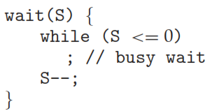

n-Process CS Problem
Shared data:
semaphore S = 1;
Structure of P_{i}
do { critical section remainder section } while (1);
wait( S );
signal( S );
4

Slide 5
Semaphore Types
OS often distinguishes between binary & counting semaphores
Binary semaphore
  binary semaphore can have only two values: 0 & 1
  “used in situations where only one process, at a time,
  is allowed to access a particular resource”
  binary semaphore is similar to mutex lock
    in systems with no support for mutex, binary semaphore can be used to provide mutual exclusion
5

Slide 6
Semaphore Types
Counting semaphore
  can have value > 1
    allow multiple processes or threads to access a limited resource concurrently, up to a specified count
    used to manage access to a finite number of identical resources
  Usage:
    semaphore initialized to “count” of resources available
    process needing a resource, calls wait(), decrements count
    when resource released, calls signal(), increments count
    when count == 0, all resources are busy
    now, if a process needs a resource it blocks, until count > 0
6

Slide 7
Busy Waiting
This definition of wait() & signal() involves busy waiting
  Problem: wasted CPU cycles
  Solution: modify definition of semaphore
Solution: if process calls wait(), and semaphore value is not positive:
  process blocks, instead of busy waiting
  process placed in wait queue associated with semaphore
  state of process changed to waiting
  control transferred to CPU scheduler, select another process
  blocked process waiting on semaphore is restarted, if some other process executes signal() operation
7

Slide 8
Semaphore – Queue Waiting
Define semaphore ‘S’ as a record…
typedef struct {
int value;
struct process *list;
} semaphore;
Each semaphore has an integer value, & list of processes
  when process must wait on a semaphore, it is added to the list
  of processes
Assume two simple operations:
  block() : suspends the process, that invokes it
  wakeup(P) : resumes execution of blocked process P
8
Notes:
It is an integer variable but also has list of variables attached with it.

Slide 9
Semaphore – Queue Waiting
Semaphore operations now defined as…
void wait(semaphore S){
S.value--;
if (S.value < 0) {
add this process to S.list;
block();
}
}
negative S.value indicates
the number of processes waiting on semaphore
void signal(semaphore S){
S.value++;
if (S.value <= 0) {
remove process P from S.list;
wakeup(P);
}
}
9

Slide 10
Analysis
Busy-waiting version is better…
  when critical sections are small
  wait time for processes waiting for semaphore is less
Queue-waiting version is better…
  for long critical sections
  when waiting is for longer periods of time
10

Slide 11
Process Coordination
Semaphores can be used to enforce coordination among processes
Example:
  If we need to execute statement B in Pj, after statement A has been executed in Pi
  Use semaphore S initialized to 0
Pi Pj
 
A wait(S)
signal(S) B
11

Slide 12
Example - Process Coordination
Give a semaphore based solution for the following problem:
  Statement S1 in P1 should execute only after statement S2 in P2 has executed
  Statement S2 in P2 should execute only after statement S3 in P3 has executed
  P1 P2 P3
  
S1 S2 S3
  
12

Slide 13
Solution
  Semaphore A = 0, B = 0;
  P1 P2 P3
  
wait(A) wait(B) S3
S1 S2 signal(B)
signal(A)
  
13

Slide 14
ME, Deadlock, Starvation
Mutual Exclusion
  Only one process at a time is allowed to execute in its critical section
Deadlock
  A set of processes are said to be in deadlock state
  if every process is waiting for an event that can be caused only by another process in the set
Starvation
  indefinite blocking due to unavailability of resources
14

Slide 15
Is Semaphore a Good Solution…?
Semaphore is a powerful synchronization tool – can provide
mutual exclusion, progress & bounded wait
Mutual Exclusion
  before entering CS, process acquires the semaphore (decrements its value), which denies access to other processes
Progress
  achieved by using semaphores correctly, with properly designed algo
  ensure all processes get opportunity to execute their CS
Bounded Wait
  achieved by not letting processes wait indefinitely within semaphore
  remove processes from list associated with semaphore, using fair scheduling policies – do not use LIFO
15

Slide 16
Is Semaphore a Good Solution…?
Semaphores need to be used correctly
  wait(S) and signal(S) may be scattered among several processes
  becomes difficult to understand their effects…
“Semaphore’s ability to provide a good solution
depends on how it is configured and used,
in order to meet specific synchronization requirements
of the application”
If used incorrectly, may lead to:
  violation of ME, deadlocks, starvation
16

Slide 17
Deadlock
Consider a system consisting of two processes P0 and P1, each accessing two semaphores S and Q, set to value 1
  P0 executes wait(S), and enters its CS
  P1 executes wait(Q), and enters its CS
  P0 then executes wait(Q), and P1 executes wait(S)
  each process is now waiting for the other to call signal() to proceed further, but this will not happen, as both are now waiting
P0 P1
wait(S); wait(Q);
wait(Q); wait(S);
 
signal(S); signal(Q);
signal(Q); signal(S);
17

Slide 18
Mutual Exclusion Violation
Consider processes sharing a semaphore S, set to value 1
  process must execute wait(S) before entering CS, and signal(S) afterwards
  however, if a process interchanges the order in which wait() and signal() are called on semaphore S
    two processes may be in their CS simultaneously
P0 P1
signal(S); wait(S);
 CS
CS 
wait(S); signal(S);
18

Slide 19
Cause of Problem & Solution
Cause:
  Programming errors due to incorrect use of wait() and signal() operations
    may be honest errors, or non-cooperative programmer
Solution:
  Use of higher level language constructs, such as critical regions, monitors, & condition variables
19

Slide 20
Use of Semaphores - pthreads
Pthreads library also provides semaphores
  POSIX SEM extensions
POSIX specifies two types of semaphores:
Unnamed Semaphores
  used within single process – shared between threads of a process
  allocated & initialized in memory
Named Semaphores
  can be shared between multiple unrelated processes
  created/opened using names in the file system
20

Slide 21
Unnamed Semaphore - pthreads
Initialize unnamed semaphore:
  sem_t sem;
  sem_init(sem_t *sem, int pshared, unsigned int value)
  (to share between threads, with initial value 1)
  sem_init(&sem, 0, 1);
Protect critical section:
sem_wait(&sem); //increment & lock semaphore
<CS>
sem_post(&sem); //decrement & unlock semaphore
Destroy semaphore:
sem_destroy(&sem);
21

Slide 22
Example (Sol: Race Condition)
long balance = 0;
sem_t sem;
int main(){
pthread_t t1, t2;
sem_init(&sem, 0, 1);
pthread_create(&t1, NULL, inc, NULL);
pthread_create(&t2, NULL, dec, NULL);
pthread_join(t1,NULL); pthread_join(t2,NULL);
sem_destroy(&sem);
printf("Value of balance is :%ld\n", balance);
return 0;
}
void * dec(void * arg){
for(long i=0;i<1000000;i++){
sem_wait(&sem);
balance--;
sem_post(&sem);
}
pthread_exit(NULL);
}
void * inc(void * arg){
for(long i=0;i<1000000;i++){
sem_wait(&sem);
balance++;
sem_post(&sem);
}
pthread_exit(NULL);
}
22

Slide 23
Classic Problems of
Synchronization
23

Slide 24
Classic Problems of Synchronization
Few synchronization problems are used to represent a large class of concurrency control scenarios
  used for testing new synchronization schemes
The problems include:
  Bounded Buffer Problem
  Reader’s & Writer’s Problem
  Dining Philosopher’s Problem
We’ll discuss solution to these problems using semaphores
24

Slide 25
Bounded Buffer Problem
Consider a pool of buffers, and two processes producer and consumer…
  Producer – produces full buffers for consumer
  Consumer – produces empty buffers for producer
Empty Pool
Producer
Consumer
Full Pool
25

Slide 26
Earlier Code…
#define BUF_SIZE 5
typedef struct{ ---- } item;
item buf[BUF_SIZE];
int in = 0; //points to first empty location in buffer
where next item will be placed by producer
int out = 0; //points to first filled location in buffer
from where next item is to be consumed
int ctr = 0; //number of items in buffer
Producer Process
item nextProduced;
while(1)
{
nextProduced = getItem();
while(ctr == BUF_SIZE)
; //buf full, do nothing
buf[in] = nextProduced;
in = (in + 1) % BUF_SIZE;
ctr++; }
Consumer Process
item nextConsumed;
while(1)
{
while(ctr == 0)
; //buf empty, do nothing
nextConsumed = buf[out];
out = (out + 1) % BUF_SIZE;
ctr--;
}
26

Slide 27
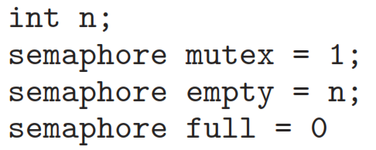
Bounded Buffer Problem
Producer and Consumer share the following data structures:
n is the number of buffers in pool, each capable of holding one item
Mutex semaphore provides mutual exclusion for accesses to buffer pool
Empty & Full semaphores count number of empty & full buffers
27

Slide 28
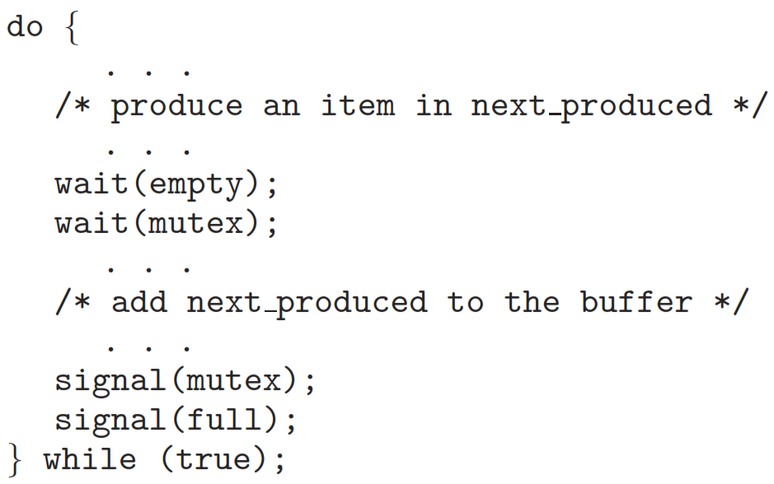
Producer Process
28

Slide 29
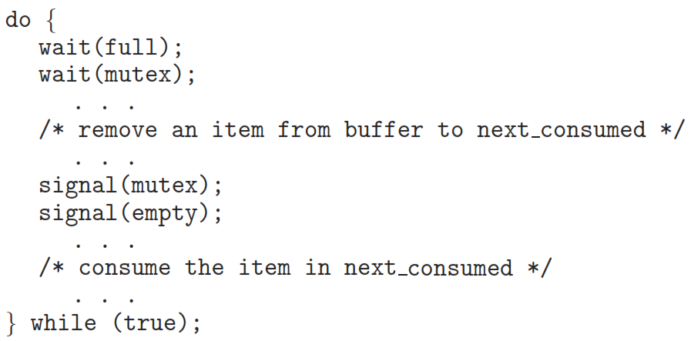
Consumer Process
29

Slide 30
Bounded Buffer Solution
#define BUF_SIZE 10
int buffer[BUF_SIZE], in = 0, out = 0;
sem_t empty, full, mutex;
int main() {
pthread_t prod_thread, cons_thread;
sem_init (&empty, 0, BUF_SIZE); sem_init (&full, 0, 0); sem_init (&mutex, 0, 1);
pthread_create (&prod_thread, NULL, producer, NULL);
pthread_create (&cons_thread, NULL, consumer, NULL);
pthread_join (prod_thread, NULL);
pthread_join (cons_thread, NULL);
sem_destroy (&empty); sem_destroy (&full); sem_destroy (&mutex);
return 0;
}
30

Slide 31
Bounded Buffer Solution
void* producer (void* arg) {
int item;
while (1) {
item = rand() % 100;
sem_wait (&empty);
sem_wait (&mutex);
buffer[in] = item;
in = (in + 1) % BUF_SIZE;
sem_post (&mutex);
sem_post (&full);
sleep (1);
}
}
void* consumer (void* arg) {
int item;
while (1) {
sem_wait (&full);
sem_wait (&mutex);
item = buffer[out];
out = (out + 1) % BUF_SIZE;
sem_post (&mutex);
sem_post (&empty);
sleep (1);
}
}
31

Slide 32







Readers Writers Problem
Consider a DB (or file) shared among concurrent processes
  some processes want to read the DB – readers
  others want to read & write the DB – writers
Readers
Writers
32

Slide 33
Readers-Writers Problem
Goal is to allow:
multiple readers to access resource simultaneously,
only one writer to access resource at a time,
and no reader to access the resource while a writer is writing
If multiple readers access shared data simultaneously
  no adverse effects
Reader
Writer
Reader
Writer
Reader
Writer
Reader
Writer
Reader
Writer
Reader
Writer
Reader
Writer
Reader
Writer
Reader
Shared Resource
33

Slide 34
Readers Writers Problem
But if a writer and some other process (reader or writer) access the DB simultaneously
  results may be uncertain
To avoid data inconsistency, requires that…
“writers have exclusive access to shared DB, while writing”
  Synchronization problem…!!!
Writer
Writer
Reader
Writer
Reader
Writer
Reader
Writer
Reader
Writer
Reader
Writer
Reader
Reader
Reader
Reader
Writer
Shared Resource
34

Slide 35
Readers Writers Problem
Several variations…
First Readers Writers problem
  no reader be kept waiting, unless a writer has already obtained permission to use the shared object
  readers are given priority over writers
  if a reader is accessing the resource, and another reader arrives, new reader is allowed access immediately, even if a writer is waiting
  writers must wait, until all readers who arrive during this wait, finish accessing the resource
Possible starvation of Writers
  if there is constant stream of readers
35

Slide 36
Readers Writers Problem
Second Readers Writers problem
  once a writer is ready,
  that writer performs its write as soon as possible
  writers are given priority over readers
  if a writer is waiting to access the resource, no new readers are allowed to start reading, until the writer has finished writing
  prevents writer starvation if there are always readers trying to access the resource
Possible starvation of Readers
  if there is constant stream of writers
36

Slide 37
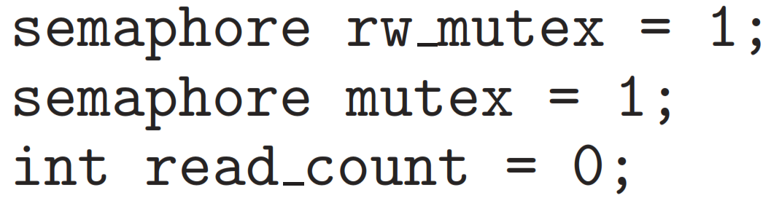
First Readers Writers Problem
Solution
This solution uses following data structures:
read_count keeps track of how many processes are currently reading
mutex semaphore ensures mutual exclusion when read_count is updated
rw_mutex semaphore…
  common to readers & writers
  writers – acts as mutual exclusion semaphore
  readers – used by ﬁrst & last reader, that enter/exit the CS
  not used by those readers, who enter or exit while other readers are in their CS
37

Slide 38
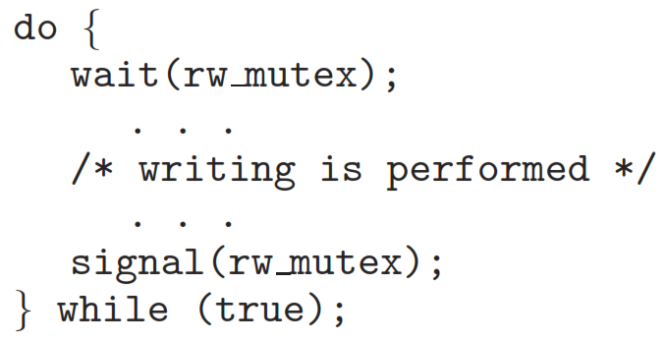
Writer Process
38

Slide 39
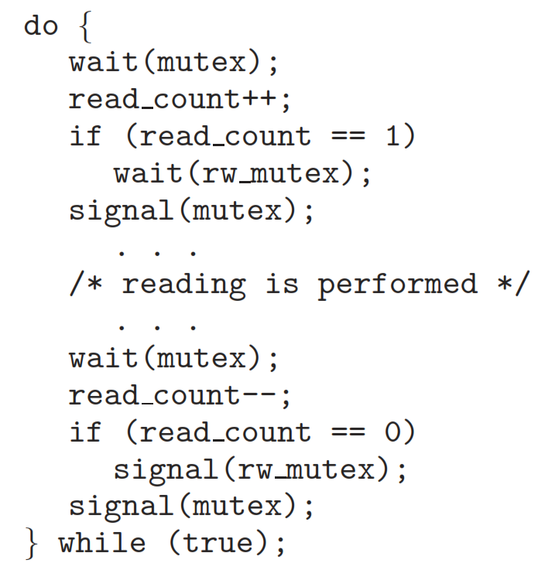
Reader Process
39

Slide 40
First Readers Writers Problem
Note that, if a writer is in CS, and n readers are waiting
  one reader is queued on rw_mutex
  and n-1 readers are queued on mutex
Also, when a writer executes signal (rw_mutex)
  may resume the execution of…
    either the waiting readers
    or a single waiting writer
  selection is made by scheduler
40

Slide 41

Dining Philosophers Problem
Five philosophers, spend their lives just thinking & eating
  only five chopsticks available to philosophers
Each philosopher mostly thinks
When he/she becomes hungry…
  picks up the two closest chopsticks, & eats
After eating, puts down the chopsticks, & starts thinking again
41

Slide 42
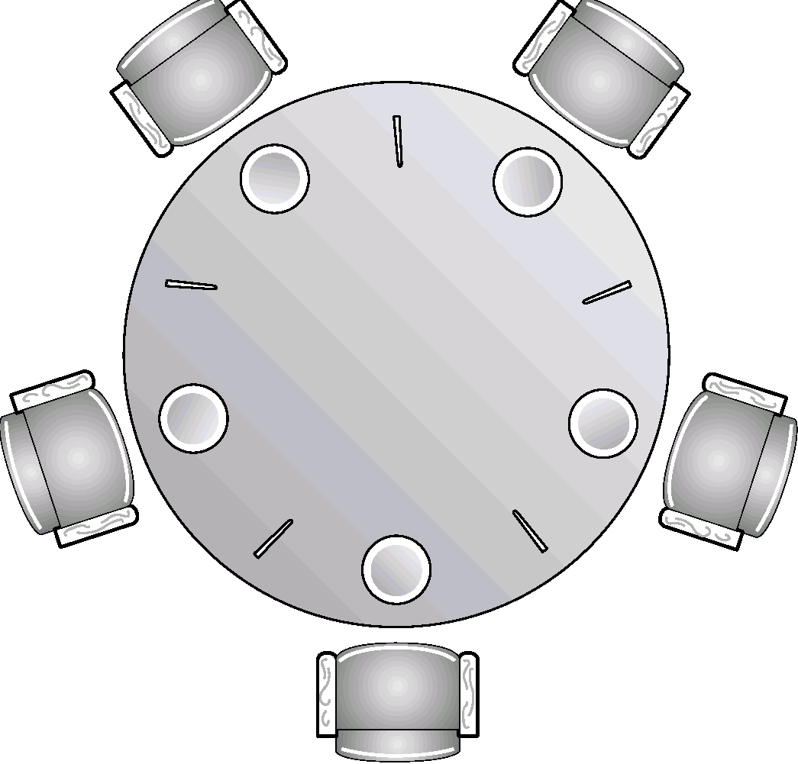
Dining Philosophers Problem
Represent each chopstick with a semaphore
Shared data: semaphore chopstick [5]
  all elements of chopstick initialized to 1
Philosopher can…
  grab a chopstick,
  by calling wait()
  release chopstick,
  by calling signal()
42

Slide 43
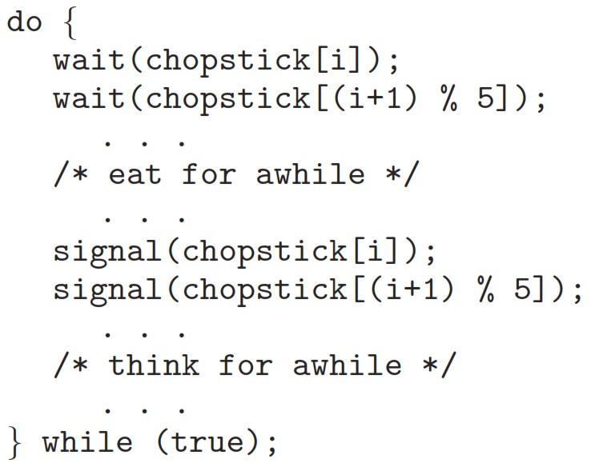
Dining Philosophers Problem
Structure of Philosopher i
43

Slide 44

Possibility of Deadlock
If all philosophers become hungry at the same time…
  they all pick up their left chopsticks
  now, all wait() for their right chopsticks
  but they are already occupied & not being released
  deadlock occurs
44

Slide 45
Possible Solutions
Allow at most four philosophers to be sitting simultaneously at the table
Allow a philosopher to pick up his chopsticks conditionally
  only if both chopsticks are available
  to do this, he must pick them up in a critical section
Use an asymmetric solution
  an odd philosopher – first picks up his left chopstick
  an even philosopher – first picks up his right chopstick, &
  then his left chopstick
45

Slide 46
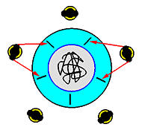
Possibility of Starvation
If two philosophers are fast eaters & fast thinkers
they may lock the chopsticks before others, every time
46

Slide 47
High level Synchronization Constructs
When using semaphores, responsibility of enforcing mutual exclusion lies with the programmer
To simplify concurrent programming, and reduce the risk of errors
  shift the responsibility from programmer to compiler and runtime environment
    Critical Regions
    Monitors
    Condition Variables
47

